Slide 1
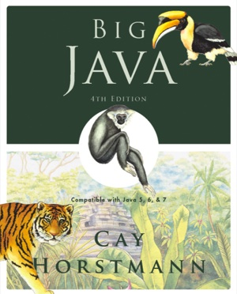
Chapter 2 – Using Objects
Big Java by Cay Horstmann
Copyright © 2009 by John Wiley & Sons. All rights reserved.

Slide 2
Chapter Goals
To learn about variables
To understand the concepts of classes and objects
To be able to call methods
To learn about parameters and return values
To be able to browse the API documentation
T To implement test programs
To understand the difference between objects and object references
Big Java by Cay Horstmann
Copyright © 2009 by John Wiley & Sons. All rights reserved.

Slide 3
Types
A type defines a set of values and the operations that can be carried out on the values
Examples:
  13 has type int
  "Hello, World" has type String
  System.out has type PrintStream
Java has separate types for integers and floating-point numbers
  The double type denotes floating-point numbers
A value such as 13 or 1.3 that occurs in a Java program is called a number literal
Big Java by Cay Horstmann
Copyright © 2009 by John Wiley & Sons. All rights reserved.

Slide 4
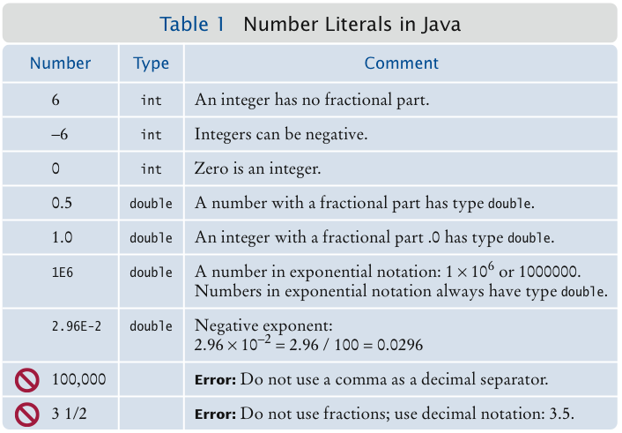
Number Literals
Big Java by Cay Horstmann
Copyright © 2009 by John Wiley & Sons. All rights reserved.

Slide 5
Number Types
A type defines a set of values and the operations that can be carried out on the values
Number types are primitive types
  Numbers are not objects
Numbers can be combined by arithmetic operators such as +, -, and *
Big Java by Cay Horstmann
Copyright © 2009 by John Wiley & Sons. All rights reserved.

Slide 6
Self Check 2.1
What is the type of the values 0 and "0"?
  Answer: int and String.

Slide 7
Self Check 2.3
Why is the expression 13.println() an error?
  Answer: An int is not an object, and you cannot call a method on it.

Slide 8
Variables
Use a variable to store a value that you want to use at a later time
A variable has a type, a name, and a value:
  String greeting = "Hello, World!”
  PrintStream printer = System.out;
  int width = 13;
Variables can be used in place of the values that they store:
  printer.println(greeting);
  // Same as System.out.println("Hello, World!”)
  printer.println(width);
  // Same asSystem.out.println(20)
Big Java by Cay Horstmann
Copyright © 2009 by John Wiley & Sons. All rights reserved.

Slide 9
Variables
It is an error to store a value whose type does not match the type of the variable:
  String greeting = 20; // ERROR: Types don’t match
Big Java by Cay Horstmann
Copyright © 2009 by John Wiley & Sons. All rights reserved.

Slide 10
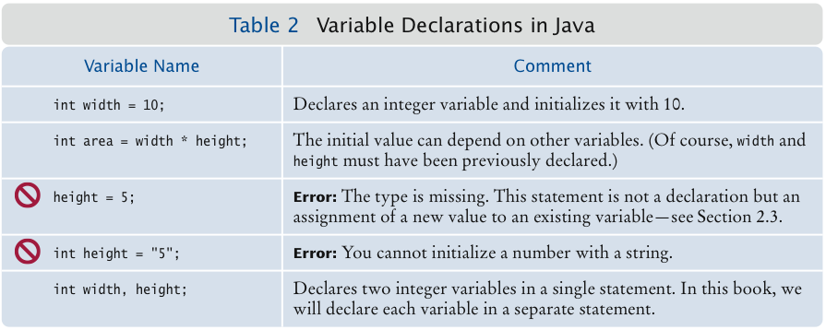
Variable Declarations
Big Java by Cay Horstmann
Copyright © 2009 by John Wiley & Sons. All rights reserved.

Slide 11
Identifiers
Identifier: name of a variable, method, or class
Rules for identifiers in Java:
  Can be made up of letters, digits, and the underscore (_) and dollar sign ($) characters
  Cannot start with a digit
  Cannot use other symbols such as ? or %
  Spaces are not permitted inside identifiers
  You cannot use reserved words such as public
  They are case sensitive
Big Java by Cay Horstmann
Copyright © 2009 by John Wiley & Sons. All rights reserved.

Slide 12
Identifiers
By convention, variable names start with a lowercase letter
  “Camel case”: Capitalize the first letter of a word in a compound word such as farewellMessage
By convention, class names start with an uppercase letter
Do not use the $ symbol in names — it is intended for names that are automatically generated by tools
Big Java by Cay Horstmann
Copyright © 2009 by John Wiley & Sons. All rights reserved.

Slide 13
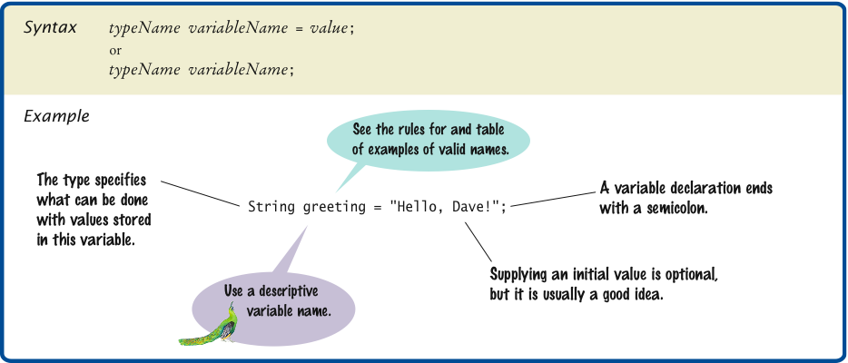
Syntax 2.1 Variable Declaration
Big Java by Cay Horstmann
Copyright © 2009 by John Wiley & Sons. All rights reserved.

Slide 14
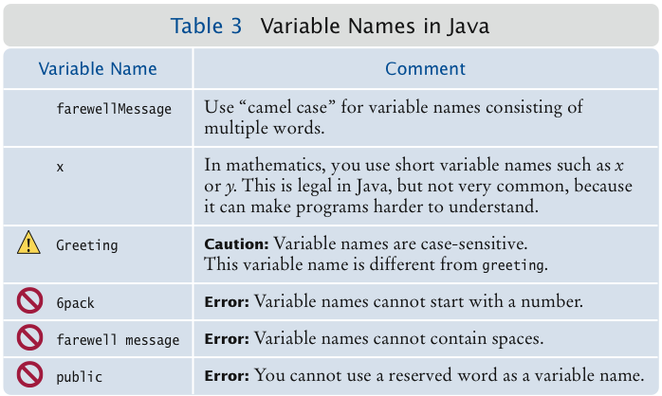
Variable Names
Big Java by Cay Horstmann
Copyright © 2009 by John Wiley & Sons. All rights reserved.

Slide 15
Self Check 2.5
Which of the following are legal identifiers?
Greeting1
g
void
101dalmatians
Hello, World
<greeting>
  Answer: Only the first two are legal identifiers.

Slide 16
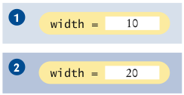

The Assignment Operator
Assignment operator: =
Used to change the value of a variable:
  int width= 10;
  width = 20;
Big Java by Cay Horstmann
Copyright © 2009 by John Wiley & Sons. All rights reserved.

Slide 17

Uninitialized Variables
It is an error to use a variable that has never had a value assigned to it:
  int height;
  width = height; // ERROR—uninitialized variable height
Remedy: assign a value to the variable before you use it:
  int height = 30;
  width = height; // OK
Even better, initialize the variable when you declare it:
  int height = 30;
  int width = height; // OK
Big Java by Cay Horstmann
Copyright © 2009 by John Wiley & Sons. All rights reserved.

Slide 18
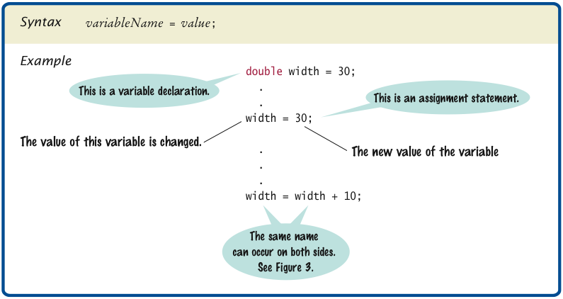
Syntax 2.2 Assignment
Big Java by Cay Horstmann
Copyright © 2009 by John Wiley & Sons. All rights reserved.

Slide 19
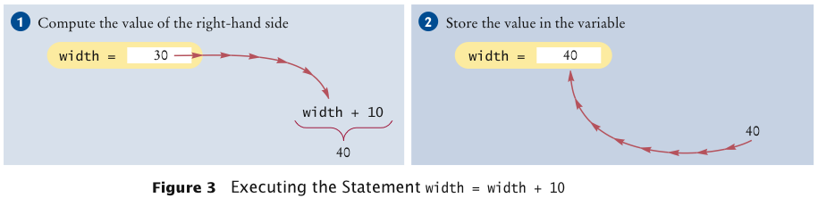
Assignment
The right-hand side of the = symbol can be a mathematical expression:
  width = height + 10;
Means:
  compute the value of width + 10
  store that value in the variable width
Big Java by Cay Horstmann
Copyright © 2009 by John Wiley & Sons. All rights reserved.

Slide 20
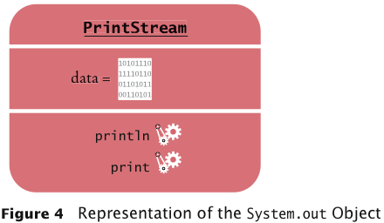
Objects and Classes
Object: entity that you can manipulate in your programs (by calling methods)
Each object belongs to a class
Example: System.out belongs to the class PrintStream
Big Java by Cay Horstmann
Copyright © 2009 by John Wiley & Sons. All rights reserved.

Slide 21
Methods
Method: sequence of instructions that accesses the data of an object
You manipulate objects by calling its methods
Class: declares the methods that you can apply to its objects
Class determines legal methods:
String greeting = "Hello";
greeting.println() // Error
greeting.length() // OK
Public Interface: specifies what you can do with the objects of a class
Big Java by Cay Horstmann
Copyright © 2009 by John Wiley & Sons. All rights reserved.

Slide 22
Overloaded Method
Overloaded method: when a class declares two methods with the same name, but different parameters
  Example: the PrintStream class declares a second method, also called println, as
    public void println(int output)
Big Java by Cay Horstmann
Copyright © 2009 by John Wiley & Sons. All rights reserved.

Slide 23
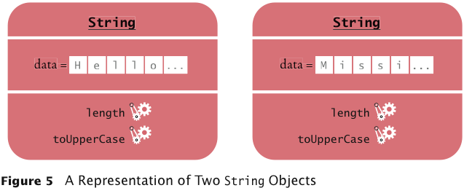
A Representation of Two String Objects
Big Java by Cay Horstmann
Copyright © 2009 by John Wiley & Sons. All rights reserved.

Slide 24
String Methods
length: counts the number of characters in a string:
String greeting = "Hello, World!";
int n = greeting.length(); // sets n to 13
toUpperCase: creates another String object that contains the characters of the original string, with lowercase letters converted to uppercase:
  String river = "Mississippi";
  String bigRiver = river.toUpperCase();
  // sets bigRiver to "MISSISSIPPI"
When applying a method to an object, make sure method is defined in the appropriate class:
System.out.length(); // This method call is an error
Big Java by Cay Horstmann
Copyright © 2009 by John Wiley & Sons. All rights reserved.

Slide 25
Self Check 2.10
How can you print out the uppercase version of
"Hello, World!"?
  Answer:
    System.out.println(greeting.toUpperCase());

Slide 26
Parameters
Parameter: an input to a method
Implicit parameter: the object on which a method is invoked:
  System.out.println(greeting)
Explicit parameters: all parameters except the implicit parameter:
  System.out.println(greeting)
Not all methods have explicit parameters:
  greeting.length() // has no explicit parameter
Big Java by Cay Horstmann
Copyright © 2009 by John Wiley & Sons. All rights reserved.

Slide 27
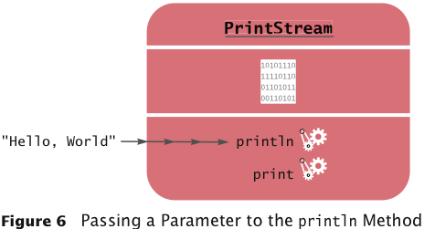
Passing a Parameter
Big Java by Cay Horstmann
Copyright © 2009 by John Wiley & Sons. All rights reserved.

Slide 28
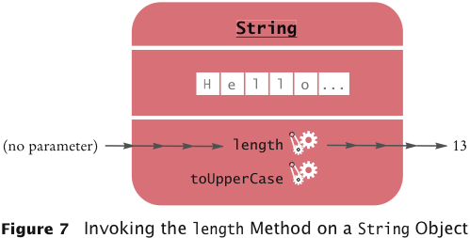
Return Values
Return value: a result that the method has computed for use by the code that called it:
  int n = greeting.length(); // return value stored in n
Big Java by Cay Horstmann
Copyright © 2009 by John Wiley & Sons. All rights reserved.

Slide 29
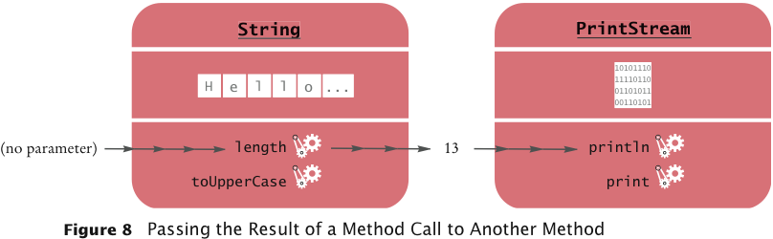
Passing Return Values
You can also use the return value as a parameter of another method:
  System.out.println(greeting.length());
Not all methods return values. Example: println
Big Java by Cay Horstmann
Copyright © 2009 by John Wiley & Sons. All rights reserved.

Slide 30
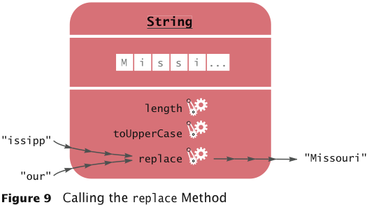
A More Complex Call
String method replace carries out a search-and-replace operation:
  river.replace("issipp", "our”)
  // constructs a new string ("Missouri")
This method call has
  one implicit parameter: the string "Mississippi"
  two explicit parameters: the strings "issipp" and "our"
  a return value: the string "Missouri"
Big Java by Cay Horstmann
Copyright © 2009 by John Wiley & Sons. All rights reserved.

Slide 31
Self Check 2.15
How is the toUpperCase method defined in the String class?
  Answer: As public String toUpperCase(), with no explicit parameter and return type String.

Slide 32
Constructing Objects
Construction: the process of creating a new object
The four values 5, 10, 20, and 30 are called the construction parameters
Some classes let you construct objects in multiple ways:
  new Rectangle()
  // constructs a rectangle with its top-left corner
  // at the origin (0, 0), width 0, and height 0
Big Java by Cay Horstmann
Copyright © 2009 by John Wiley & Sons. All rights reserved.

Slide 33
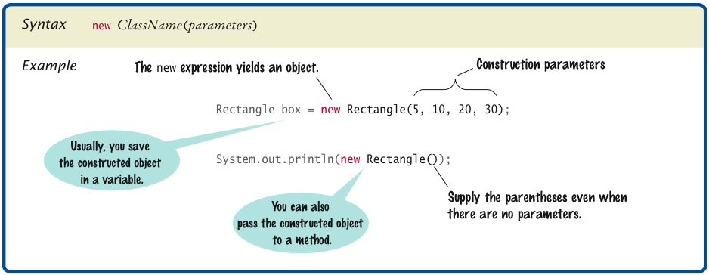
Syntax 2.3 Object Construction
Big Java by Cay Horstmann
Copyright © 2009 by John Wiley & Sons. All rights reserved.

Slide 34
Self Check 2.17
The getWidth method returns the width of a Rectangle object. What does the following statement print?
System.out.println(new Rectangle().getWidth()); Answer:
    0

Slide 35
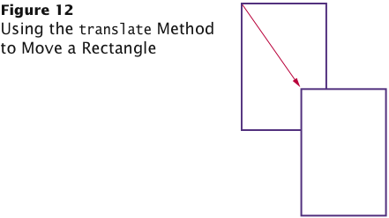
Accessor and Mutator Methods
Accessor method: does not change the state of its implicit parameter:
  double width = box.getWidth();
Mutator method: changes the state of its implicit parameter:
  box.translate(15, 25);
Big Java by Cay Horstmann
Copyright © 2009 by John Wiley & Sons. All rights reserved.

Slide 36
Self Check 2.18
Is the toUpperCase method of the String class an accessor or a mutator?
  Answer: An accessor – it doesn’t modify the original string but returns a new string with uppercase letters.

Slide 37
The API Documentation
API: Application Programming Interface
API documentation: lists classes and methods in the Java library
http://java.sun.com/javase/7/docs/api/index.html
Big Java by Cay Horstmann
Copyright © 2009 by John Wiley & Sons. All rights reserved.

Slide 38
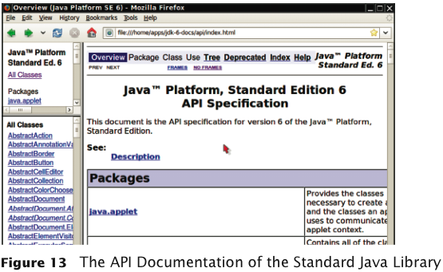
The API Documentation of the Standard Java Library
Big Java by Cay Horstmann
Copyright © 2009 by John Wiley & Sons. All rights reserved.

Slide 39
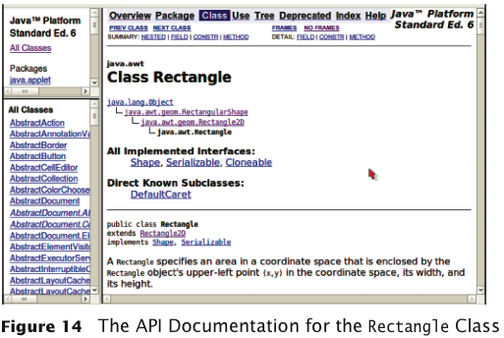
The API Documentation for the Rectangle Class
Big Java by Cay Horstmann
Copyright © 2009 by John Wiley & Sons. All rights reserved.

Slide 40
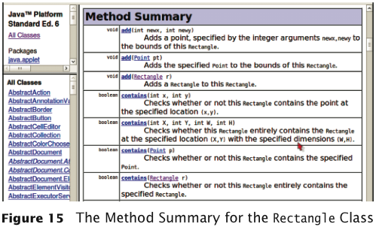
Method Summary
Big Java by Cay Horstmann
Copyright © 2009 by John Wiley & Sons. All rights reserved.

Slide 41
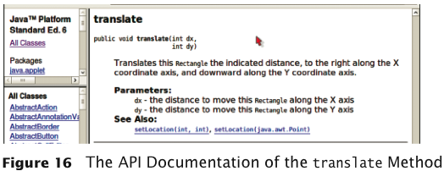
Detailed Method Description
The detailed description of a method shows:
The action that the method carries out
The parameters that the method receives
The value that it returns (or the reserved word void if the method doesn’t return any value)
Big Java by Cay Horstmann
Copyright © 2009 by John Wiley & Sons. All rights reserved.

Slide 42
Packages
Package: a collection of classes with a related purpose
Import library classes by specifying the package and class name:
  import java.awt.Rectangle;
You don’t need to import classes in the java.lang package such as String and System
Big Java by Cay Horstmann
Copyright © 2009 by John Wiley & Sons. All rights reserved.

Slide 43
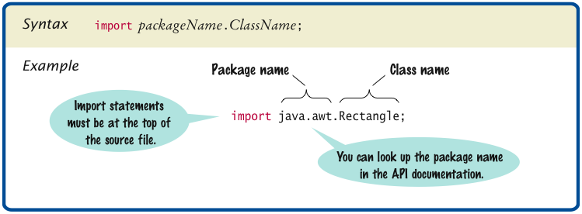
Syntax 2.4 Importing a Class from a Package
Big Java by Cay Horstmann
Copyright © 2009 by John Wiley & Sons. All rights reserved.

Slide 44
Self Check 2.20
Look at the API documentation of the String class. Which method would you use to obtain the string "hello, world!" from the string "Hello, World!"?
  Answer: toLowerCase

Slide 45
Self Check 2.21
In the API documentation of the String class, look at the description of the trim method. What is the result of applying trim to the string " Hello, Space ! "? (Note the spaces in the string.)
  Answer: "Hello, Space !" – only the leading and trailing spaces are trimmed.

Slide 46
Self Check 2.22
The Random class is defined in the java.util package. What do you need to do in order to use that class in your program?
  Answer: Add the statement
    import java.util.Random;
  at the top of your program.

Slide 47
Object References
Object reference: describes the location of an object
The new operator returns a reference to a new object:
Rectangle box = new Rectangle();
Multiple object variables can refer to the same object:
Rectangle box = new Rectangle(5, 10, 20, 30);
Rectangle box2 = box;
box2.translate(15, 25);
Primitive type variables ≠ object variables
Big Java by Cay Horstmann
Copyright © 2009 by John Wiley & Sons. All rights reserved.

Slide 48
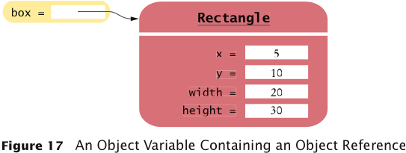
Object Variables and Number Variables
Big Java by Cay Horstmann
Copyright © 2009 by John Wiley & Sons. All rights reserved.

Slide 49
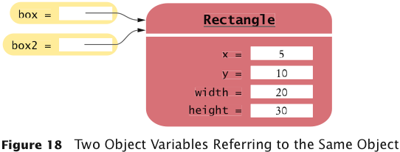

Object Variables and Number Variables
Big Java by Cay Horstmann
Copyright © 2009 by John Wiley & Sons. All rights reserved.

Slide 50

Copying Numbers
int luckyNumber = 13;
Big Java by Cay Horstmann
Copyright © 2009 by John Wiley & Sons. All rights reserved.

Slide 51
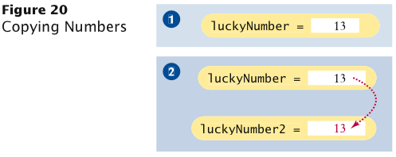
Copying Numbers (cont.)
int luckyNumber = 13;
int luckyNumber2 = luckyNumber;
Big Java by Cay Horstmann
Copyright © 2009 by John Wiley & Sons. All rights reserved.

Slide 52
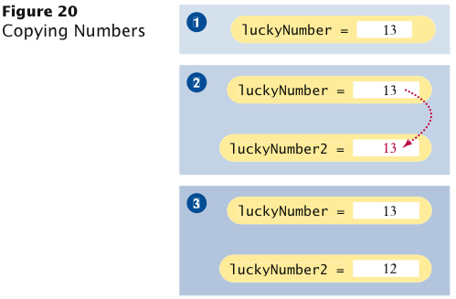
Copying Numbers (cont.)
int luckyNumber = 13;
int luckyNumber2 = luckyNumber;
luckyNumber2 = 12;
Big Java by Cay Horstmann
Copyright © 2009 by John Wiley & Sons. All rights reserved.

Slide 53
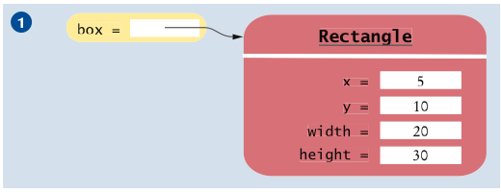
Copying Object References
Rectangle box = new Rectangle(5, 10, 20, 30);
Big Java by Cay Horstmann
Copyright © 2009 by John Wiley & Sons. All rights reserved.

Slide 54
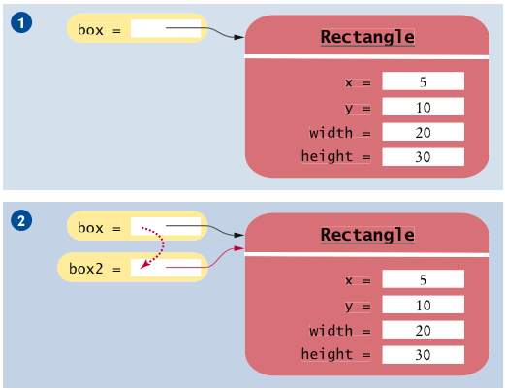
Copying Object References (cont.)
Rectangle box = new Rectangle(5, 10, 20, 30);
Rectangle box2 = box;
Big Java by Cay Horstmann
Copyright © 2009 by John Wiley & Sons. All rights reserved.

Slide 55
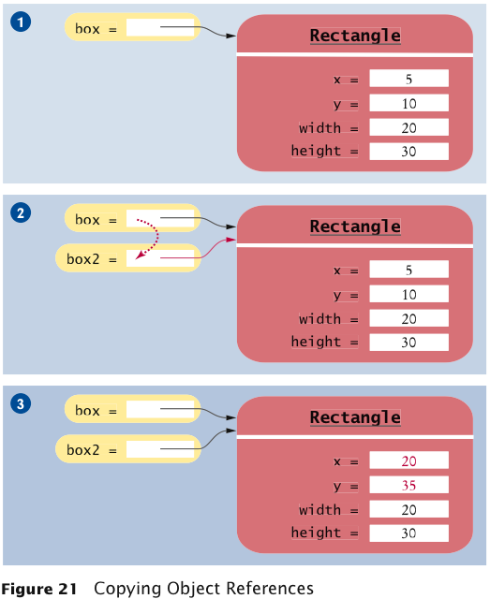
Copying Object References (cont.)
Rectangle box = new Rectangle(5, 10, 20, 30);
Rectangle box2 = box;
Box2.translate(15, 25);
Big Java by Cay Horstmann
Copyright © 2009 by John Wiley & Sons. All rights reserved.

Slide 56
Self Check 2.25
What is the effect of the assignment greeting2 = greeting?
  Answer: Now greeting and greeting2 both refer to the same String object.

Slide 57
Self Check 2.26
After calling greeting2.toUpperCase(), what are the contents of greeting and greeting2?
  Answer: Both variables still refer to the same string, and the string has not been modified. Recall that the toUpperCase method constructs a new string that contains uppercase characters, leaving the original string unchanged.

